Slide 1
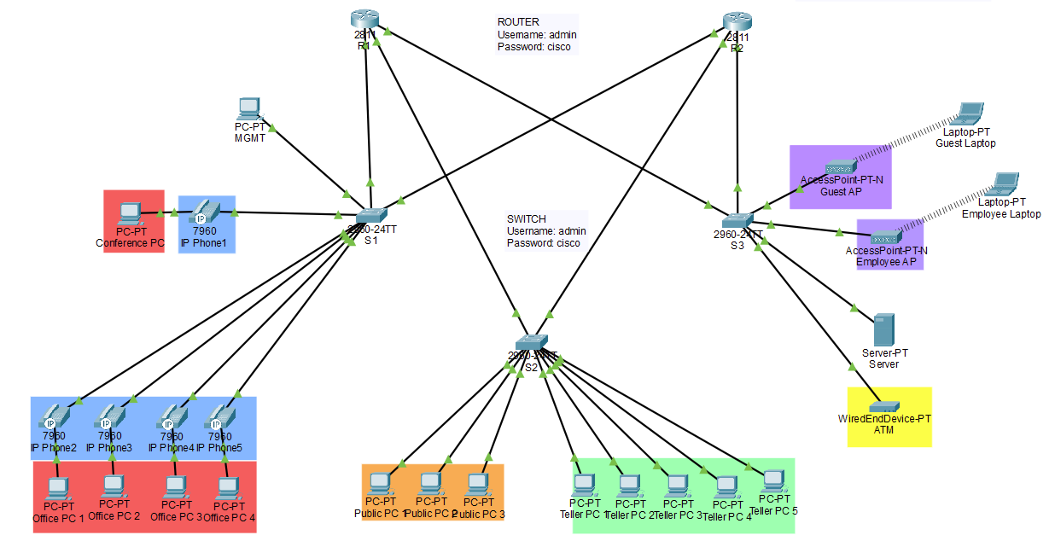


Designing a Banking Network with High Security Protocols
Project Scope & Requirements
Process (MDDDE)
Functionality
IT 491 Capstone Project
Christian Monterrosa
Daniel Rodriguez
Charles Romanowski
Dhruvitsinh Rana
Design a secure and reliable infrastructure for a banking network within the Cisco Packet Tracer program.
Protect sensitive financial data and personally identifiable information stored by the bank.
Ensure quality components, service, and uptime for the bank’s clients and employees to completed tasks.
We utilized the SCRUM framework by splitting our workload between four sprints and conducting several meetings throughout each week.
Sprint progress was tracked utilizing the GitHub Projects board and GANTT chart.
A project risk matrix was developed in order to identify and address potential roadblocks prior to their occurrence.
Layer 2 switching
VLAN segmentation
Inter-VLAN routing
DHCP
Guest and employee wireless networks secured through WPA2
Firewall
Voice Over IP (VoIP) phones
Port security
Router redundancy and failover
RADIUS server
Secured lines
Secured devices
Disabled DTP

